Slide 1
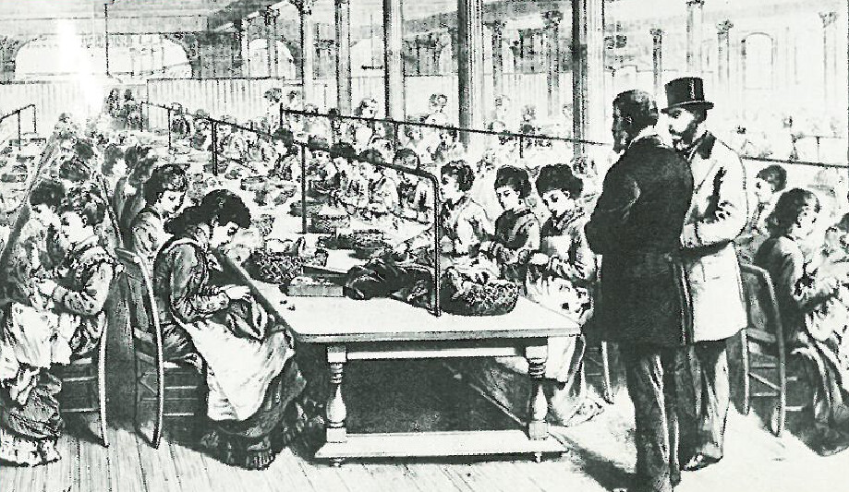

The Industrial Revolution
Lektionstips-sprakstorning.spsm.se
Bild från flickr.com, licensierad enligt CC BY-SA-NC

Slide 2
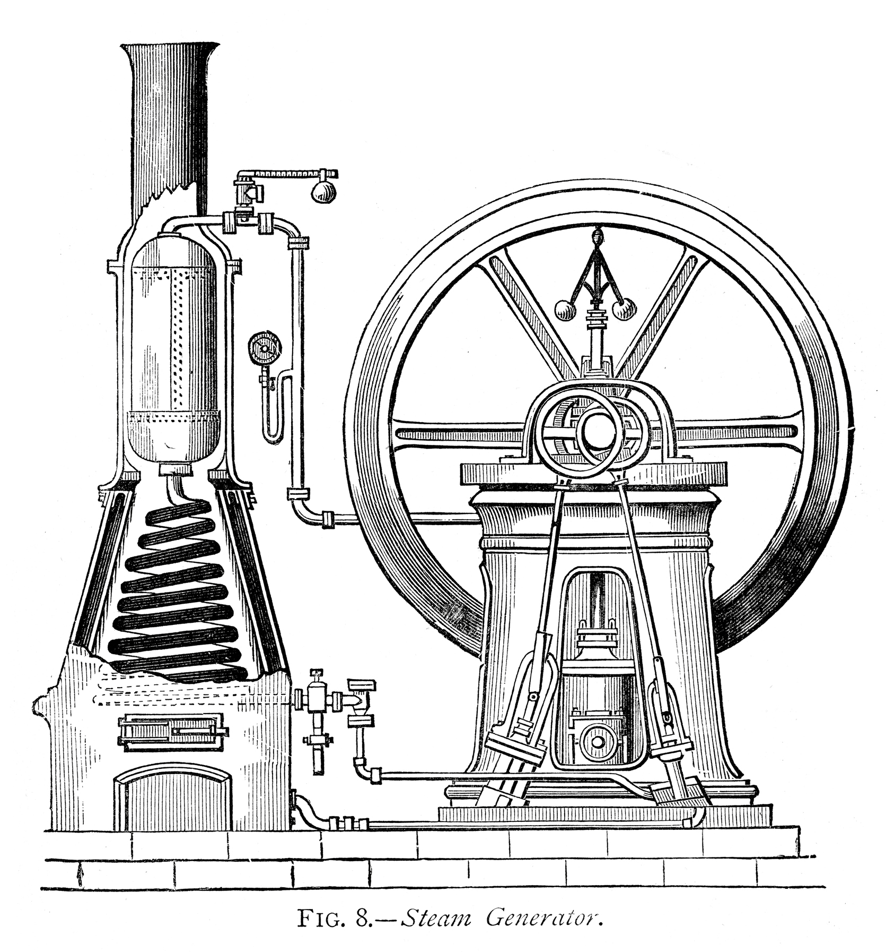
The Industrial Revolution
It began in Great Britain in the 18th century.
“If you go back to 1800, everybody was poor. I mean everybody. The Industrial Revolution kicked in, and a lot of countries benefited, but by no means everyone.” – Bill Gates
Many of the technological innovations came from Britain.
The revolution spread across Europe and the United States.
New ideas were applied to mining, metalwork, and the transport of goods.
The most important invention was the steam engine
- It powered factories and drained deep mines from water.
- It was used in railway engines.
- Burning coal became the main source of energy.
Bild: duncan1890, DigitalVision Vectors via Getty Images

Slide 3
Positive changes
Over time, living standards rose.
People generally became richer and healthier.
More children survived to be adults, instead of dying from hunger or disease.
Population growth.
Negative changes
Men, women and even children had to work long hours for very low wages.
Workdays often lasted 12, 14, or even 18 hours.
Many families lived in overcrowded apartments.
Family members often had to take turns sleeping because the shared small spaces and worked at different times.
Long work hours made it hard for families to spend time together.

Slide 4
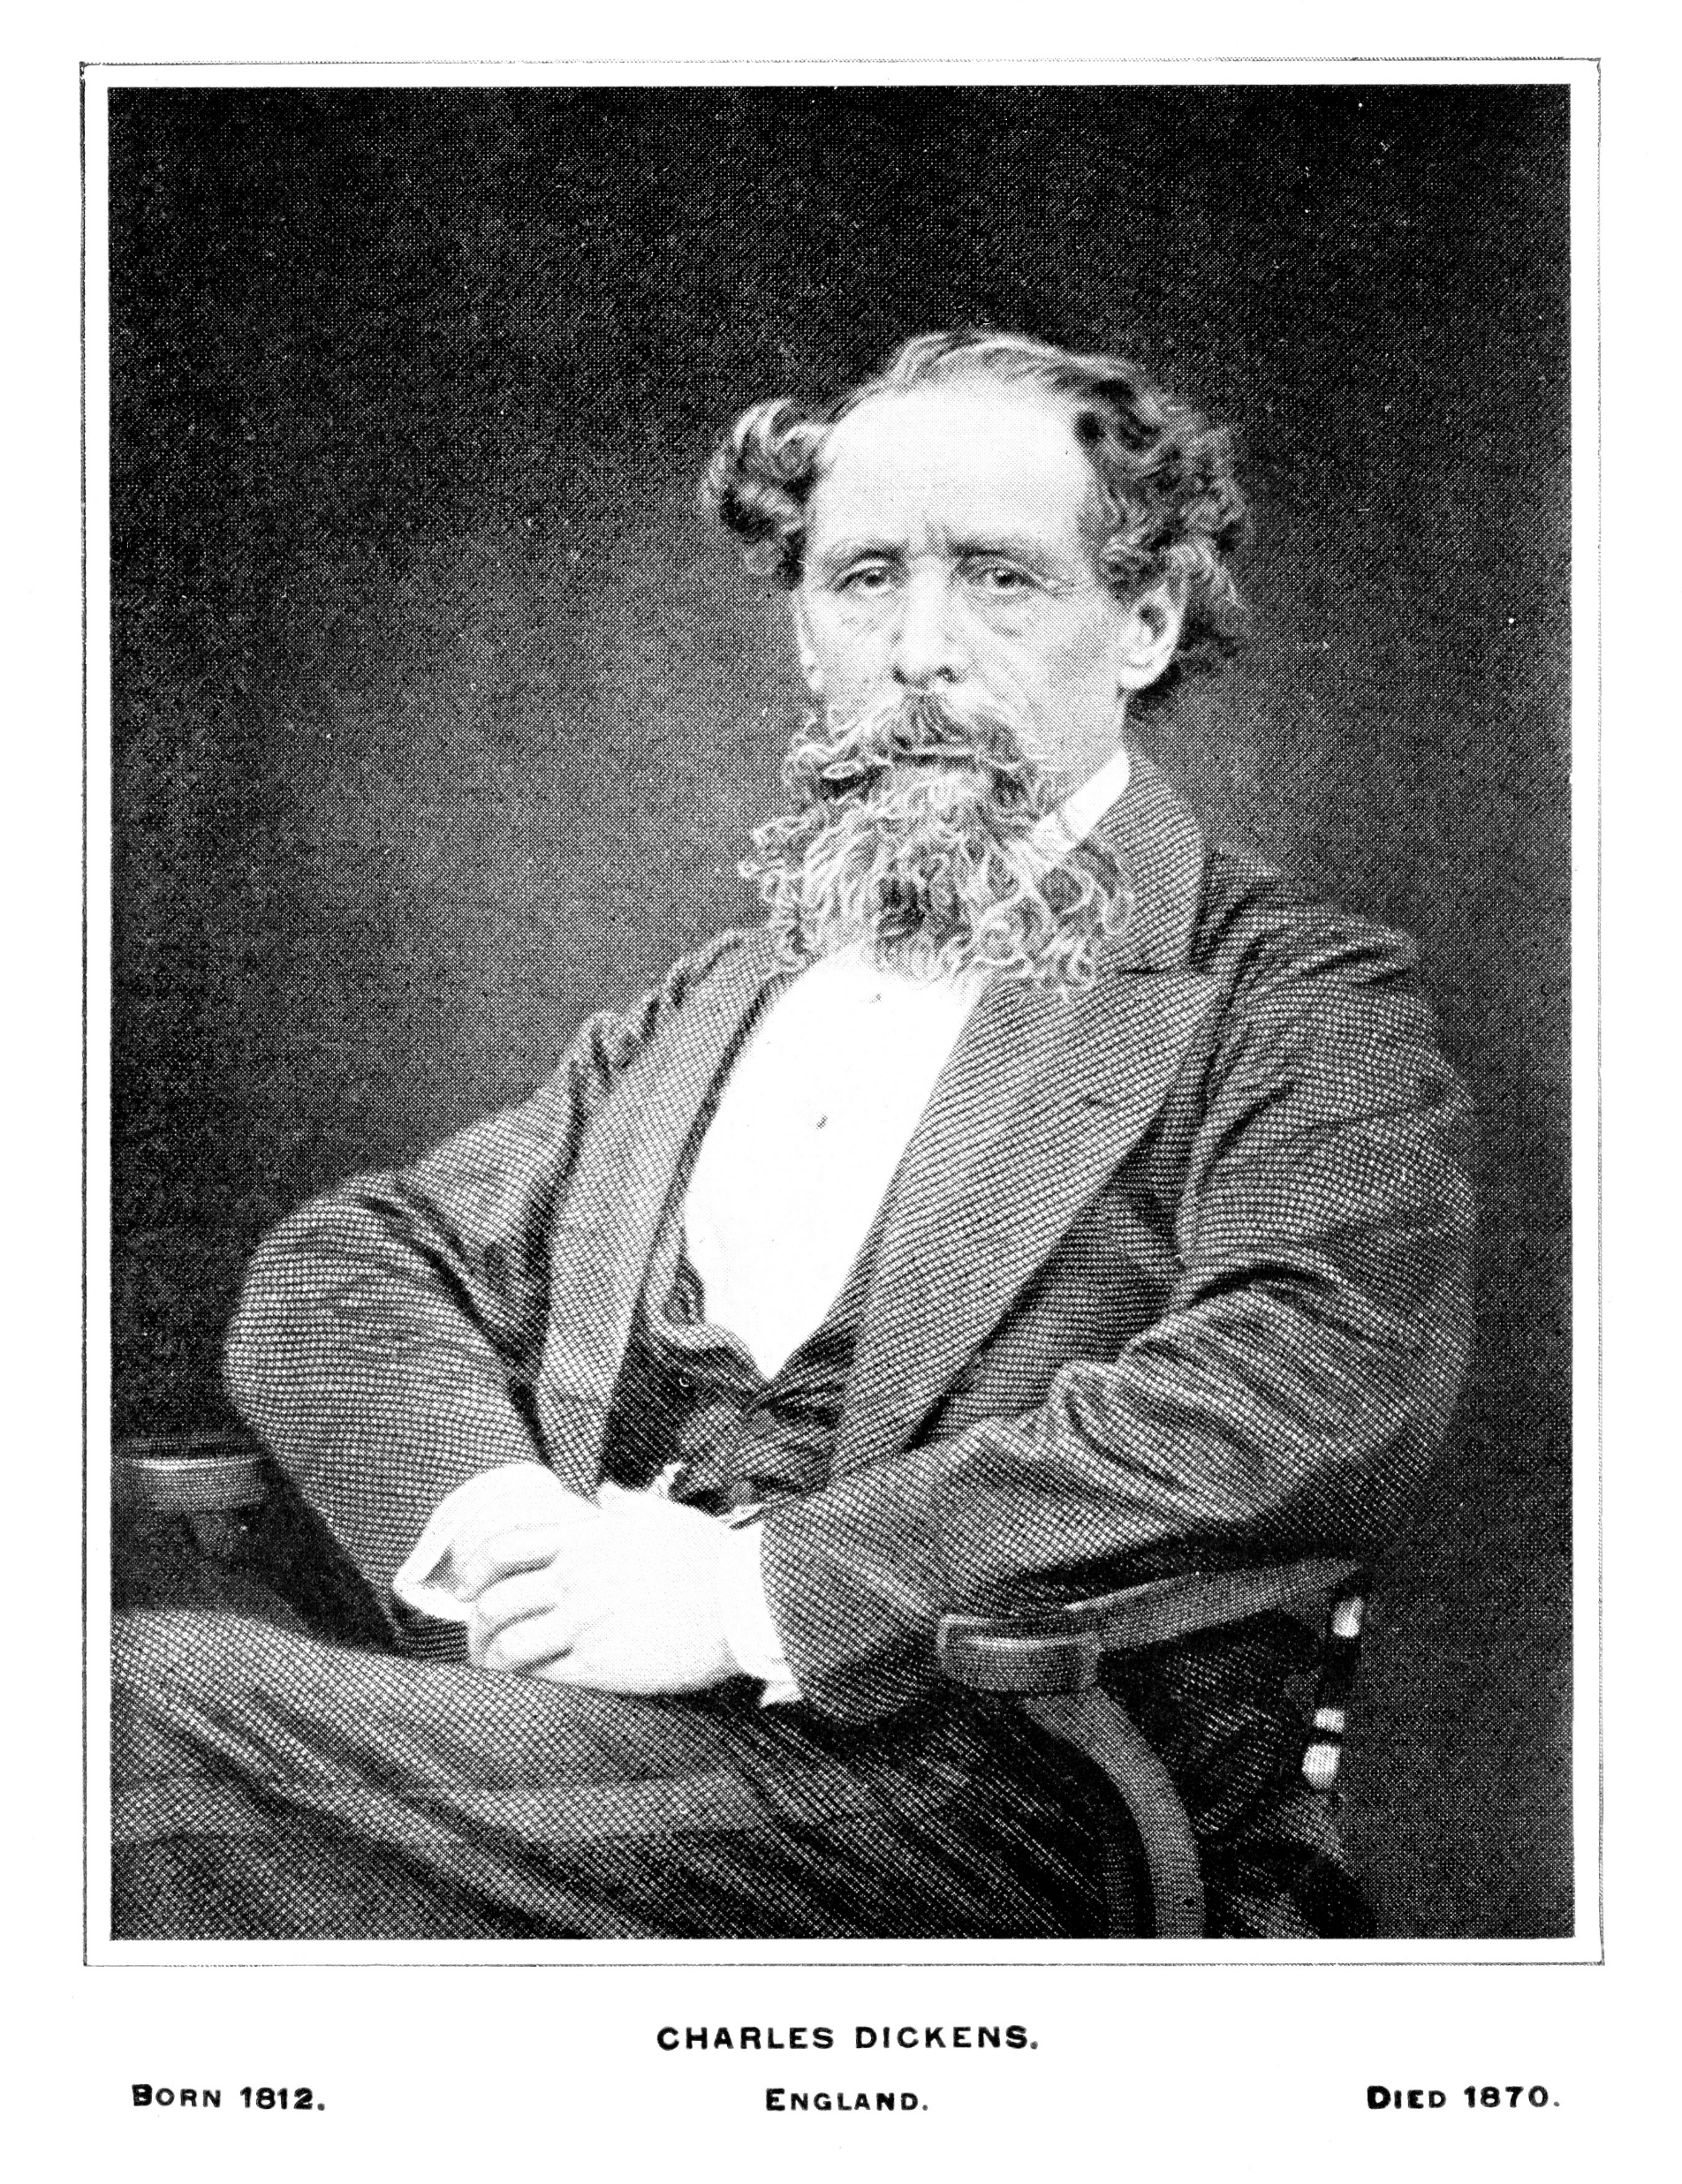
Charles Dickens
British author.
Born in 1812.
Grew up during the Industrial Revolution, a time of major social and economic change.
In 1824, his father was sent to prison for not paying his debts.
As a child, Dickens had to work at a factory to pay the money his family owed.
These early hardships shaped his writing.
His stories reveal what life was like in Victorian times, especially for poor families and children.
In 1837, Oliver Twist is published.
Bild: Christine_Kohler, iStock GettyImages

Slide 5
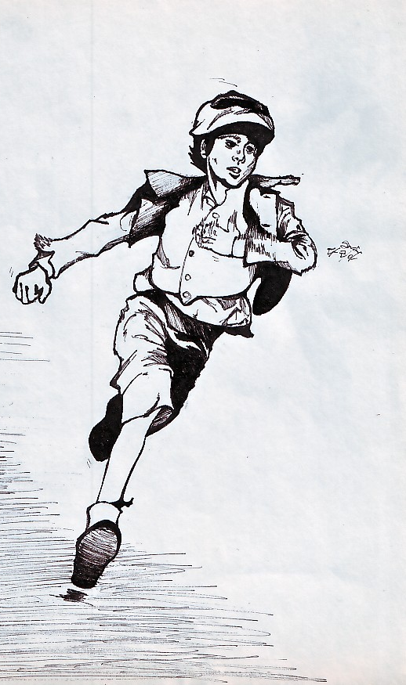
Oliver Twist
A young orphan, living in Victorian London.
His mother dies during childbirth.
He is sent to a workhouse, where poor children are made to live and work.
The children are treated badly and given very little food.
There are no caring adults or role models to support them.
Oliver’s story shows the harsh reality for poor children in Victorian London, shaped by the Industrial Revolution.
Illustration: Botan. Licensierad enligt CC BY-SA-NC

